Slide 1
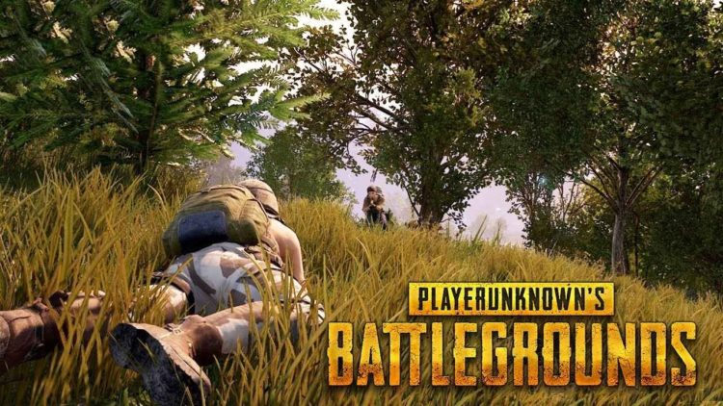
Flex scores – Find where the action is
Team: Force of Mortality
Paddu, Simon, Muthu, Aniketh, Vivek, Yash
This Photo by Unknown Author is licensed under CC BY

Slide 2
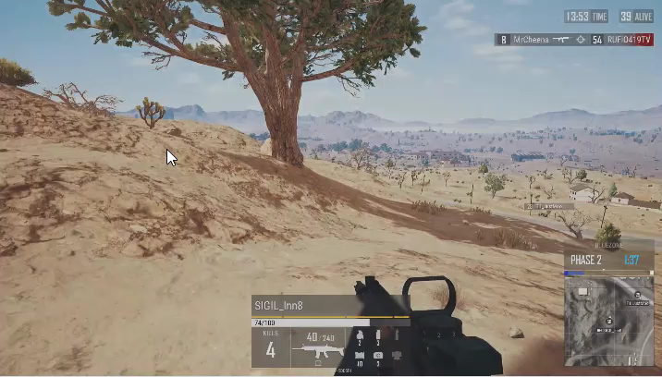
What can be improved?

Slide 3
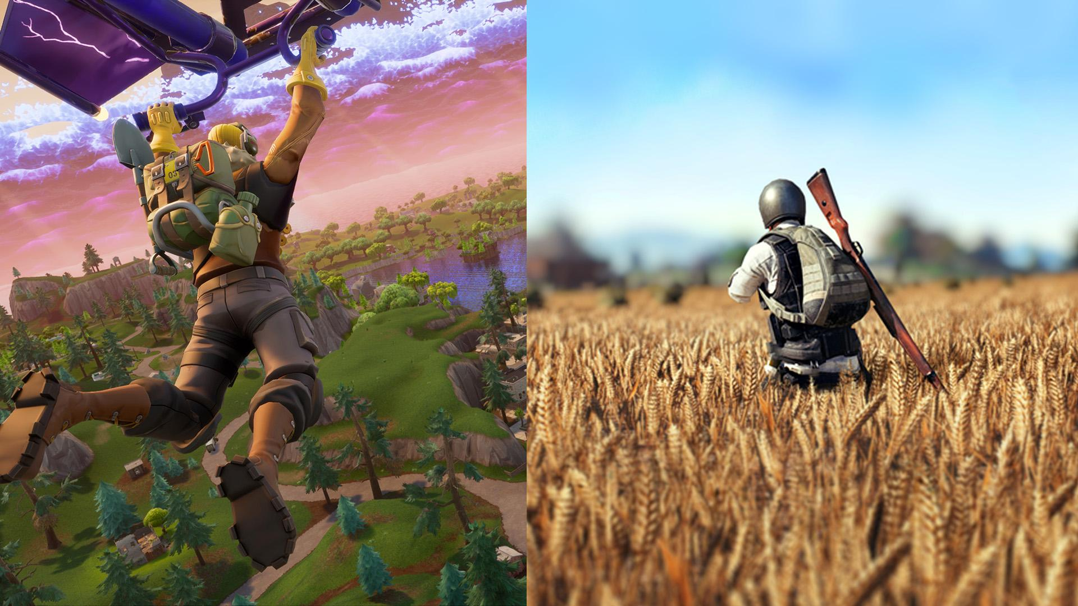
Engaging users using data-centric broadcasts
Develop a real-time scoring metric which indicates chances of a good finish
Increased engagement with streaming viewers
Identifying top performers within a given match provides a way to assess performance within a game
Leverage historical player performance + current match events to evaluate overall performance
This Poto by Unknown Author is licensed under CC BY-NC-ND

Slide 4

Approach
We followed a 3-stage process to come up with the real-time scores:
Use historical aggregated matches’ data from PUBG to identify which metrics drive success for a player
Use play-by-play information from the PUBG APIs to train a model on the current matches data to come up with a real-time score
Combine the historical + real-time scores to identify the top-performers in a live match to drive viewer engagement
This Photo by Unknown Author is licensed under CC BY-SA-NC

Slide 5
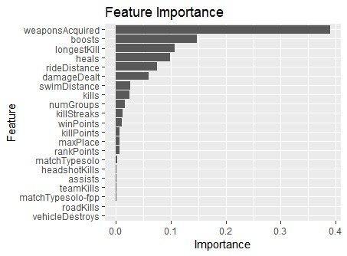
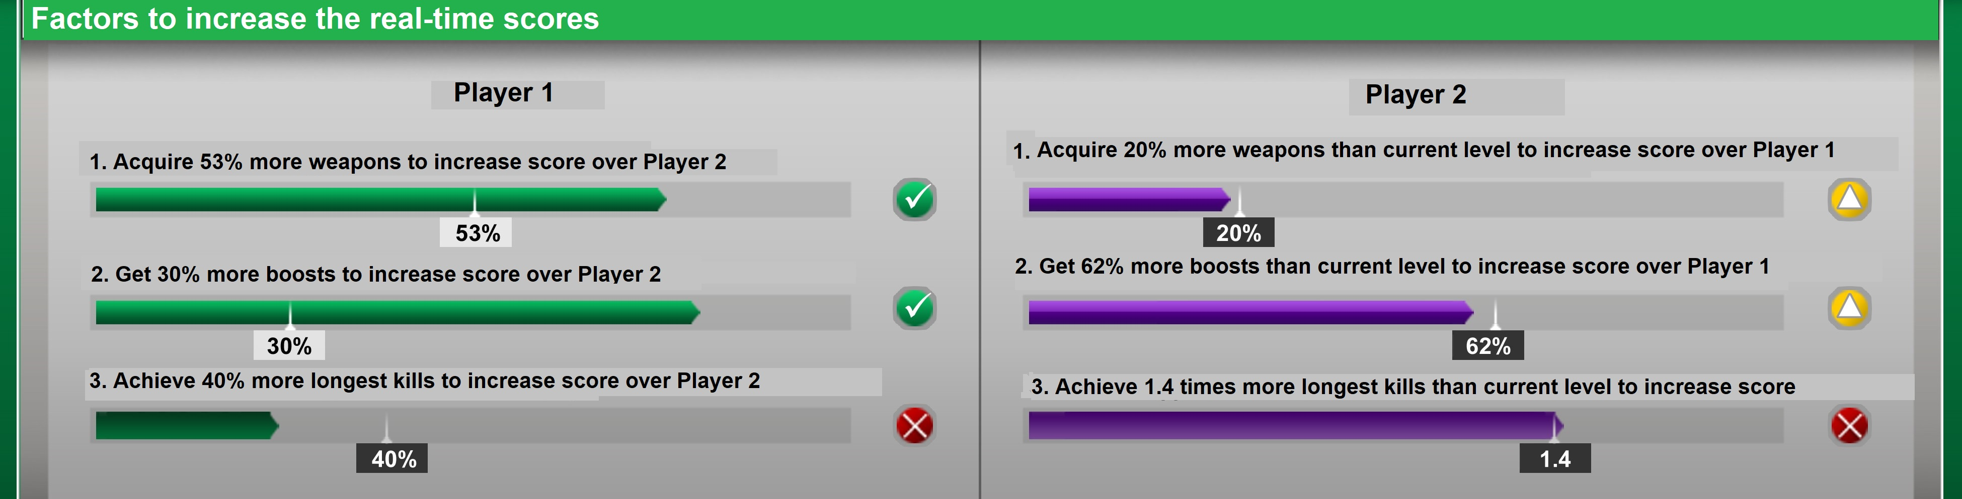
What impacts the score
Identified key factors that cause score to increase
We show which factors will increase real-time scores
Betters will find this feature useful

Slide 6
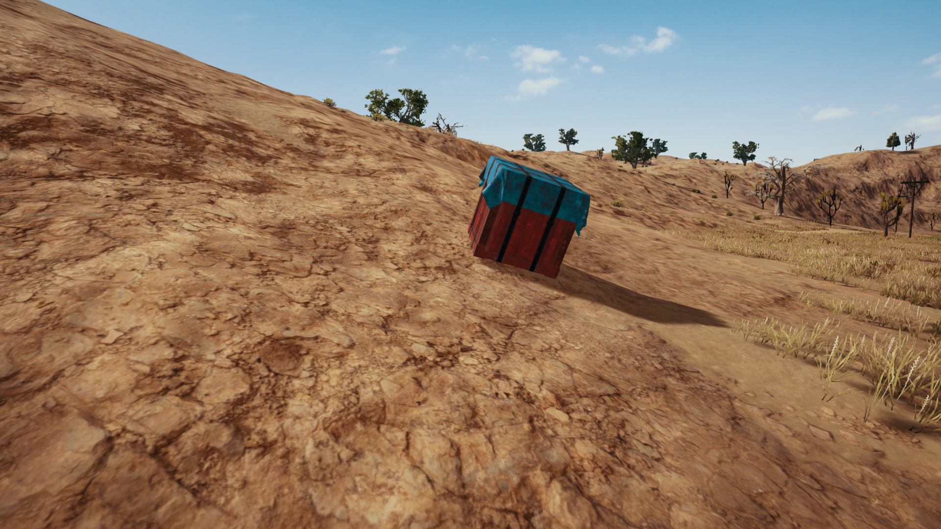
Methodology
Train a historical performance model using aggregated player-match data
Identify important metric drivers which define player success
Pre-process, pre-process & pre-process to extract the useful information from the resulting JSONs
Iteratively train the play-by-play model as and when new events like kills, damage events & revives happen
Aggregate historical and real-time scores for a given live test match
This Photo by Unknown Author is licensed under CC BY-SA-NC

Slide 7

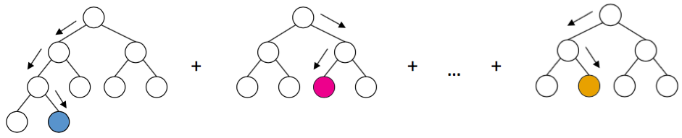
Technical Aspects
Train aggregate match data
Test aggregate matches
Get Historical Scores
40k matches
500k players
20k matches
200k players
XG-Boost
This Photo by Unknown Author is licensed under CC BY-NC-ND

Slide 8
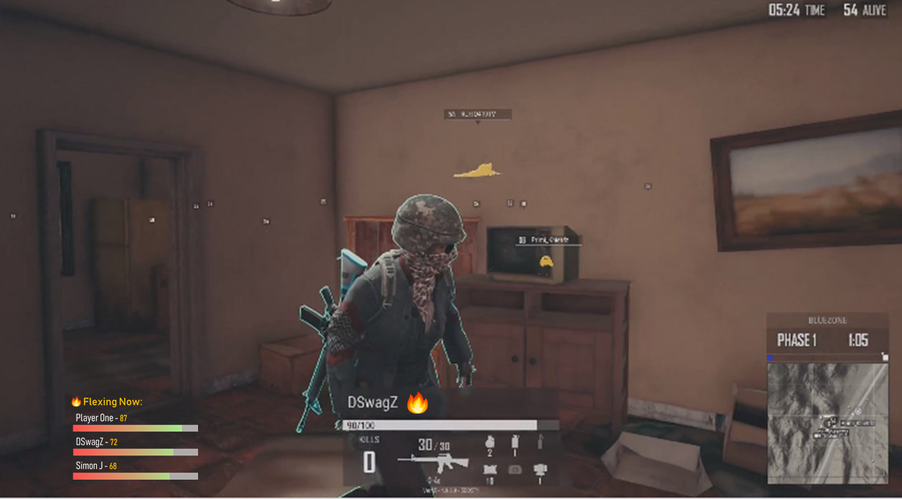
Sample of real-time score visualization
Sliders showing the scores of top players in the bottom left
Real-time indication of performance in live coverage

Slide 9
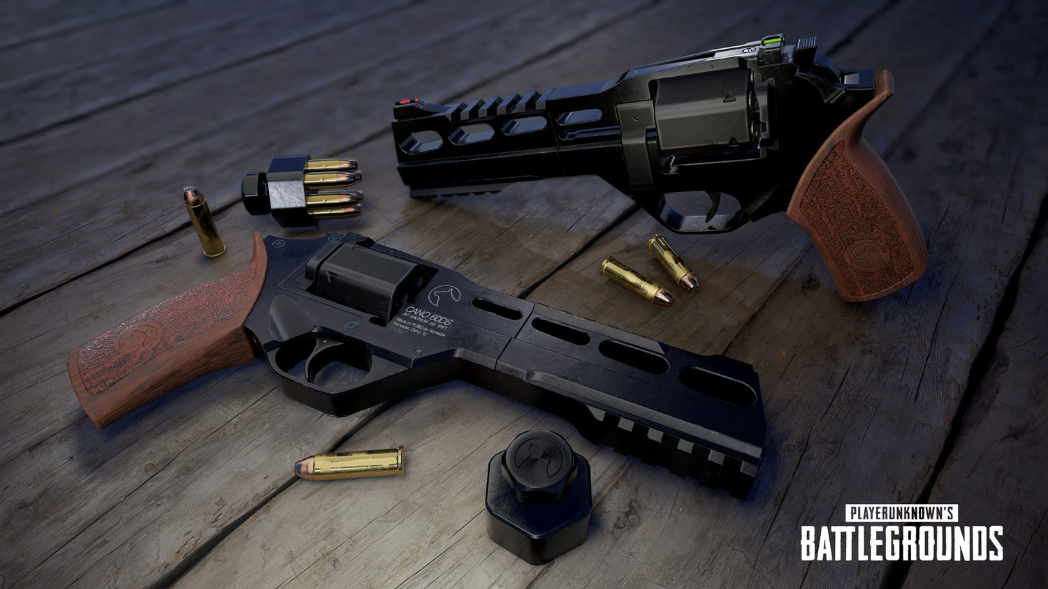

Technical Aspects
Event 1
Event 2
Event 3
Dealt damage
Took Damage
Took a booster for health
Event timeline
Real-time modeling
(Recurrent Neural Network)
Modeling
Live match scores for players
Output
This Photo by Unknown Author is licensed under CC BY-NC

Slide 10

Innovations
Use play-by-play events data to capture what is happening and use it to come up with a real-time scoring system which lets you know who is performing well in a live match
We also use historical match data to influence our final score for the current match
This Photo by Unknown Author is licensed under CC BY-SA-NC

Slide 11
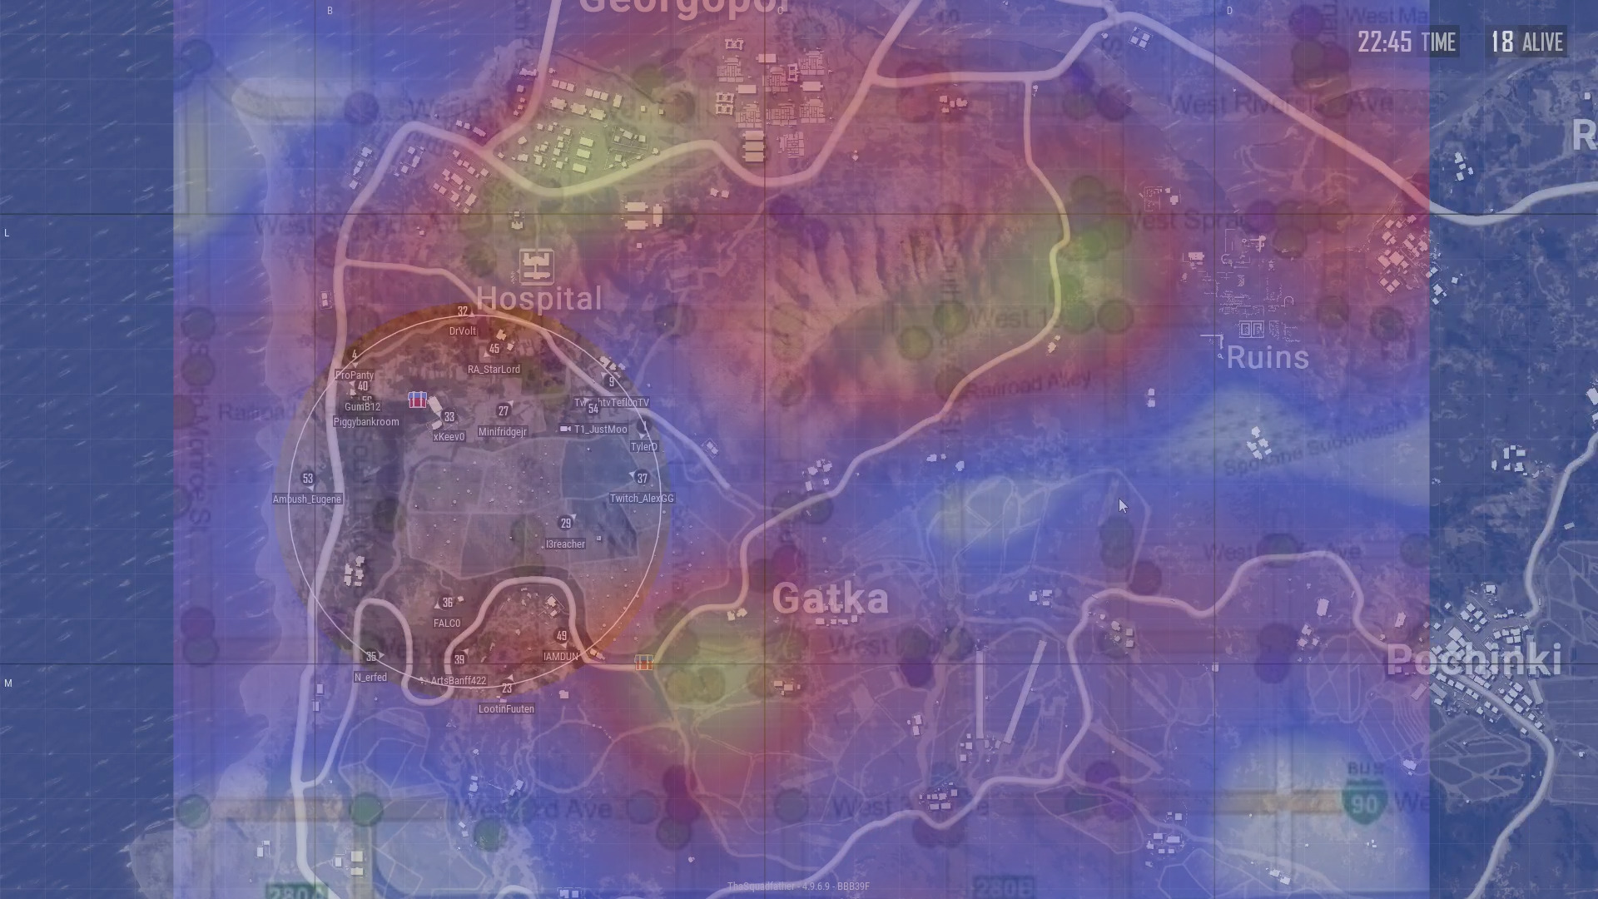
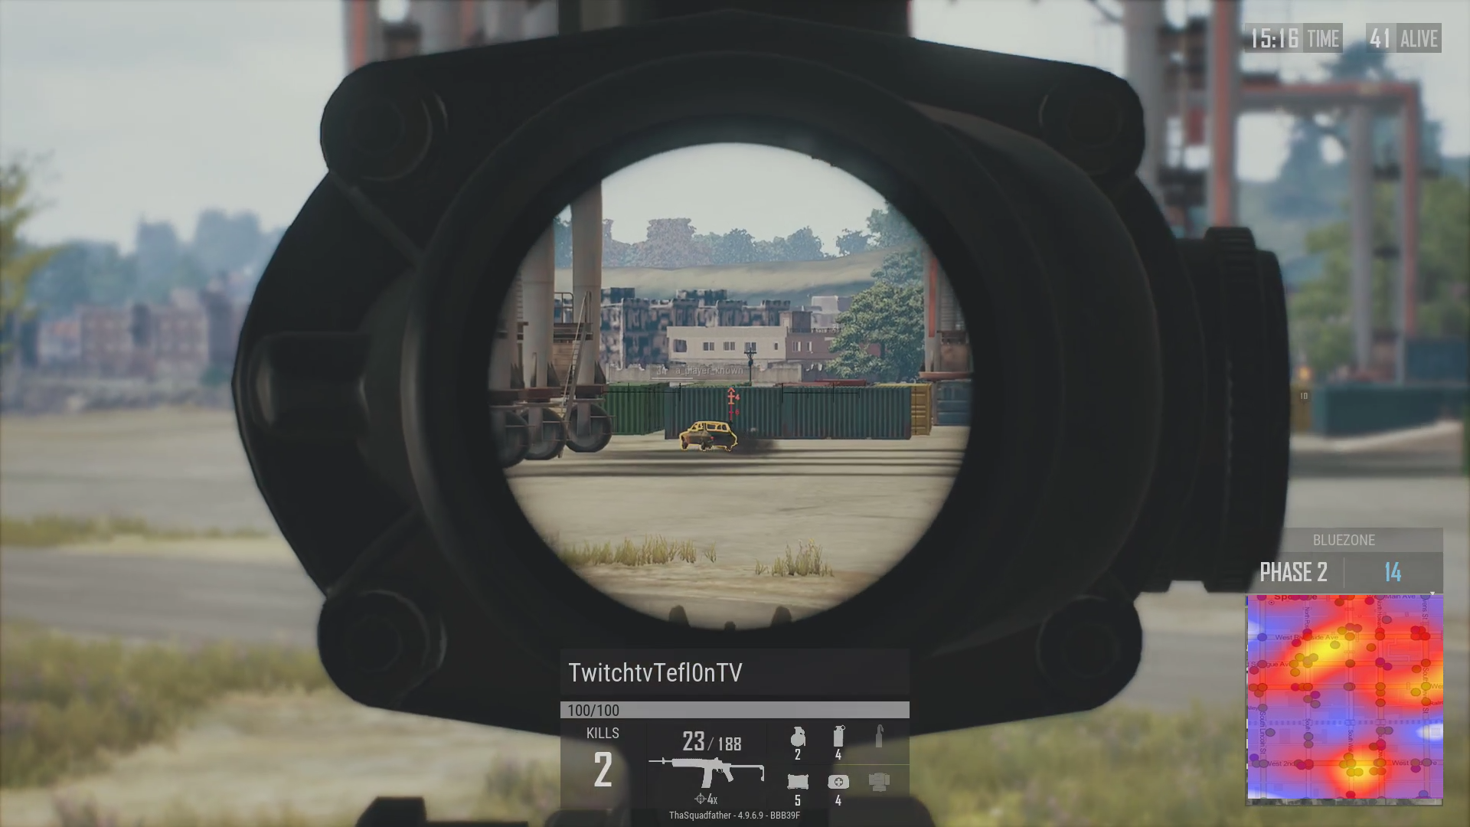
Heatmap of player scores overlaid on map
Allow commentator to show heat map of real-time scores overlaid on regular map
Enable commentator to zoom in on key areas rather than showing random areas over streaming

Slide 12
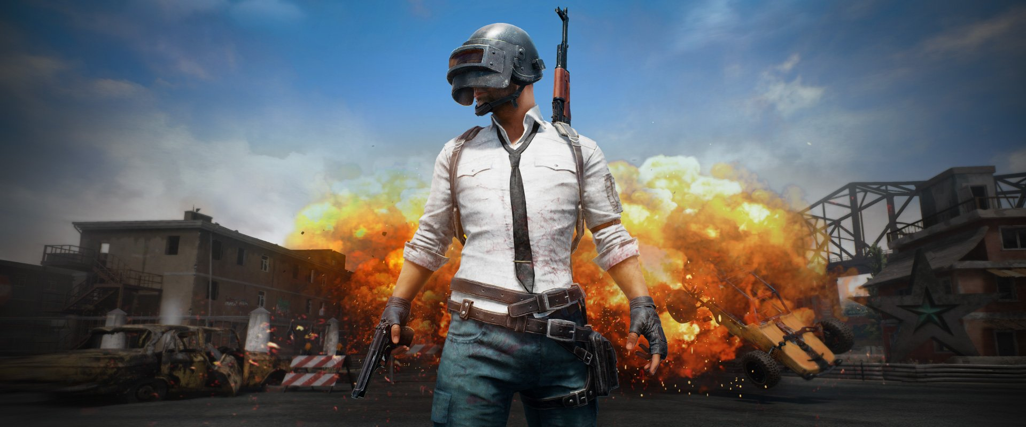
Data Insights
Player events during a match are a rich source of information that should be mined during the match
In addition to serving as player performance indicators, they can also help give interesting statistics for the match which help engage with the users
The data insights make friendly conversations between viewers during real-time screening of matches and creates good social impact
This Photo by Unknown Author is licensed under CC BY

Slide 13
Thank you!

